Slide 1








TRAINING SESSION: SOCIAL TRACK
IMPROV COMEDY
for SOCIAL ENGINEERING
open-security-summit.org
All materials will be published under a CC or open source license

Slide 2
open-security-summit.org
ALL SESSIONS AT
OPEN SECURITY SUMMIT 2020
WILL BE RECORDED AND SHARED WITH THE PUBLIC ☺
davemattingly.net @dave_mattingly
All materials will be published under a CC or open source license

Slide 3


OVERVIEW FOR TODAY
open-security-summit.org
Introduction
Overview of Social Engineering
Overview of Improv Comedy
Resources and References
PLAY!
davemattingly.net @dave_mattingly
Let me ’splain. No, there is too much. Let me sum up.

Slide 4










ABOUT THE SPEAKER
open-security-summit.org
davemattingly.net @dave_mattingly
I never did a day’s work in my life. It was all fun. (Thomas Edison)

Slide 5
SOCIAL ENGINEERING
open-security-summit.org
An act that influences a person to take an action that may not be in their best interest
Personal, Phishing, Vishing, Smishing
Watering Hole
Tailgate
Pretext
Bait & Hook
davemattingly.net @dave_mattingly
Do social engineers drive social trains?

Slide 6
THE IMPROV “RULES”
open-security-summit.org
Accept: Yes, and…
Connect: Relate to audience
Respect: Support your partner
Direct: Focus on action
Project: Follow the fear
Expect: Mistakes are gifts
Active Listening
Communication
Teamwork
Creativity
Embrace Ideas
Fearless
Resilience
Outlandish Claims
Guiding Principles
Awesome is on the other side of fear
Improv enhances every area of life
Outlandish Claims
davemattingly.net @dave_mattingly
Humor is like a fart; if you force it, it’s probably crap.

Slide 7


STAY CREATIVE
open-security-summit.org
Local Improv Groups
48-Hour Film Project, Startup Weekend, Hackathons
Games (Who Would Win, Once Upon a Time)
Creative Meetups (Creative Mornings)
Toastmasters International, Moth, Pecha Kucha
Learn, Travel, Meet – Engage!
www.sharpen.design
davemattingly.net @dave_mattingly
Never trust an atom; they make up everything.

Slide 8
REFERENCES
open-security-summit.org
social-engineer.org
cybercanon.paloaltonetworks.com
oseec.github.io/booklist
Personality Plus, Littauer
Five Love Languages, Chapman
youtu.be/BEHl2lAuWCk `vishing
youtu.be/N4kfsxF8Tio no tech
ImprovEncyclopedia.org/references/Rules_of_Improv.html
ImprovEverywhere.com
vimeo.com/176474304 John Cleese
tcat.tc/1kmYnKY improv in life
read.bi/29sSqsr improv at work
youtu.be/nIgMUO5PwMQ humor life hack
davemattingly.net @dave_mattingly
If we knew what we were doing, it wouldn’t be research. (Einstein)

Slide 9
DEMO/GAMES
open-security-summit.org
improv.ca/training/workshop-generator
Five Things
Bippity Bippity Bop
Awesome Day
Commercial Interruption
Hitchhiker
Shift Left
Murder Murder Die Die
davemattingly.net @dave_mattingly
Demo (noun): see Demolition

Slide 10
DEMO/GAMES
open-security-summit.org
Name Circle
Word Strings
Weird Potato
Invisible Juggling
List of Cheer
Coffee Like Women
davemattingly.net @dave_mattingly
Demo (noun): see Demolition

Slide 11











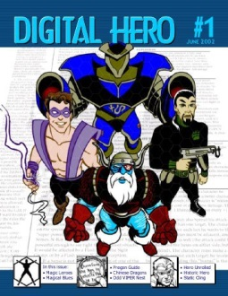

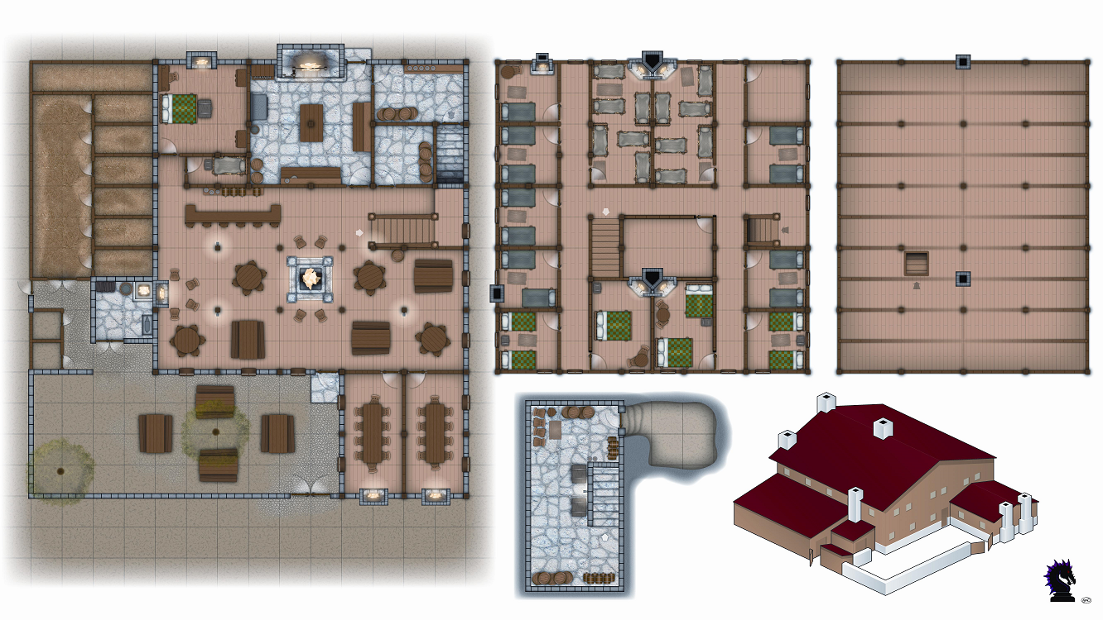


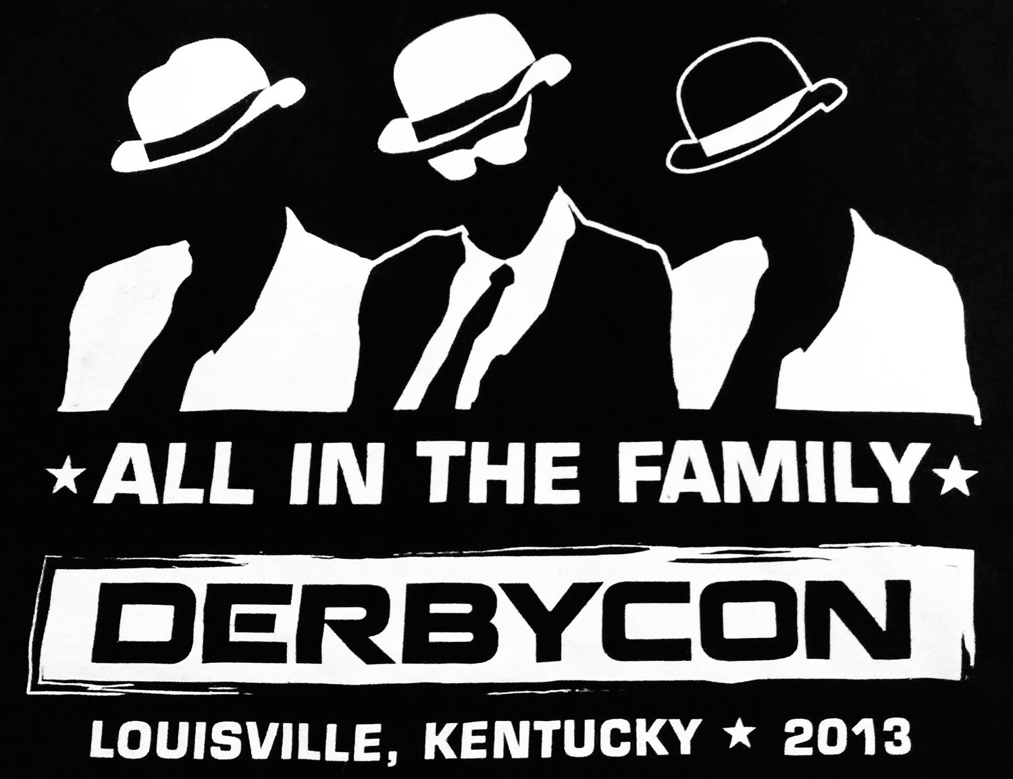


















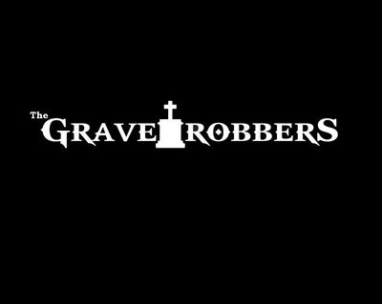
MY STORY
open-security-summit.org
davemattingly.net @dave_mattingly
Carpe D.M. Seize the Dave.

